Slide 1

Linux Services
Team Pi

Slide 2
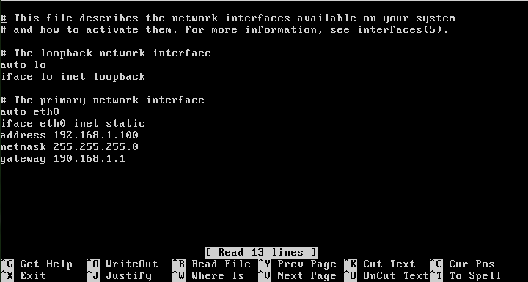
Give a static IP address
In /etc/network/interfaces change dhcp to static and specify the information.

Slide 3
SSH

Slide 4
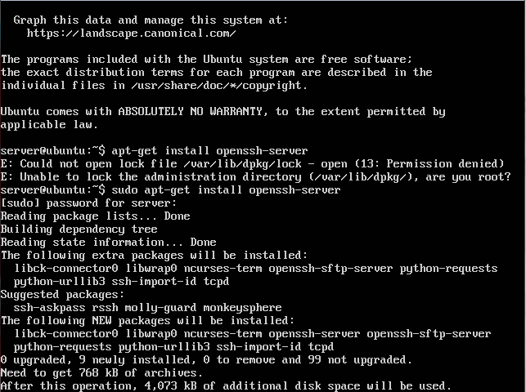
Install SSH
Use the command ‘sudo apt-get install openssh-server’

Slide 5
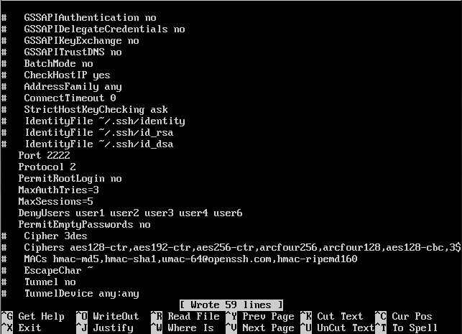
Use only version 2, Change Port to 2222, Disable root remote logging, MaxAuthTries = 3, MaxSessions = 5, Deny user 1-5, Deny permitEmptyPassword
All of these changes are made in the /etc/ssh/shh_config

Slide 6
Telnet

Slide 7
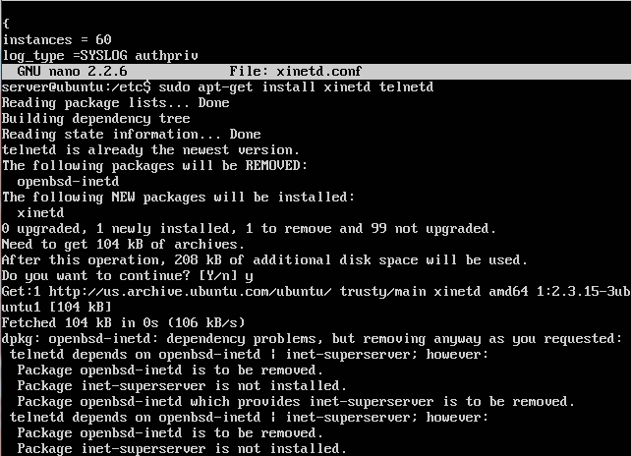
Install Telnet
Use the command: sudo apt-get install xinetd telnetd. Then type y and press enter.

Slide 8
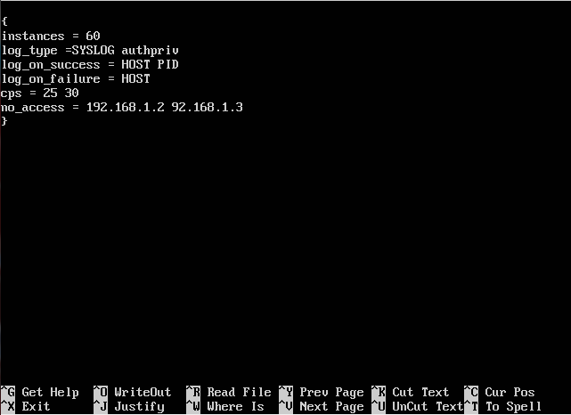
Deny access to 192.168.1.2 and 92.168.1.3
In the file located at etc/xinetd.d/telnet add this line and set the IP’s.

Slide 9
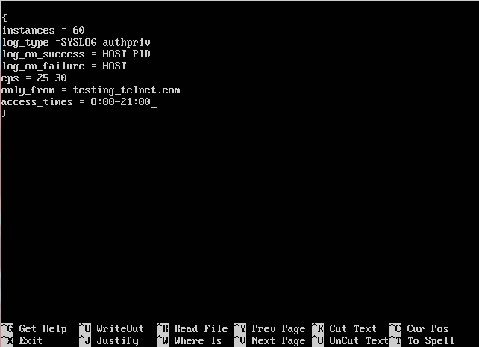
Allow connections only from domain testing_telnet.com
Configure access time = 8.00am to 9.00 pm
In the same file add this line and specify the domain to whitelist a domain or IP.
To limit access time add this line.

Slide 10
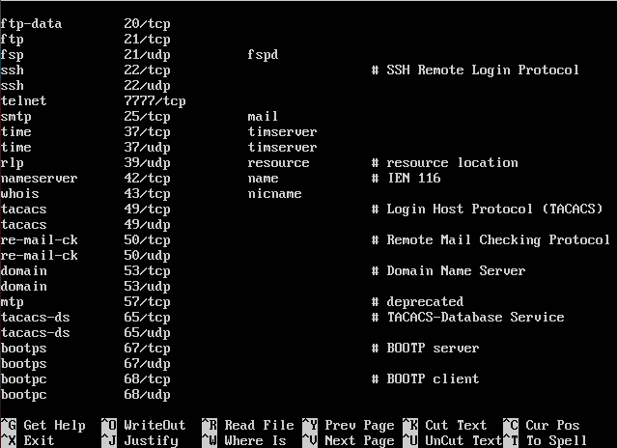
Change telnet port to 7777
Go to the services file inside of etc and change the listed telnet port to the 7777.

Slide 11
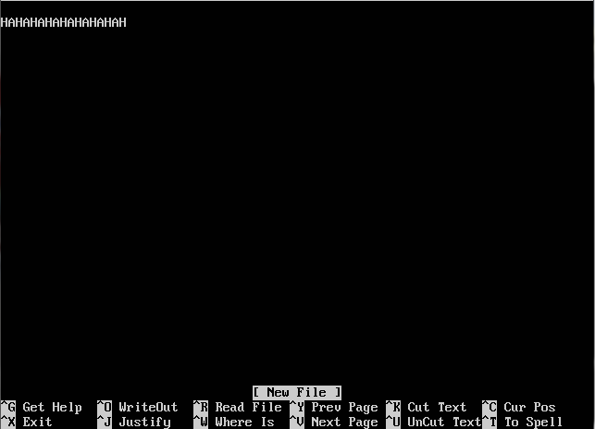
Make the banner = " HAHAHAHAHAHAHA"
The banner will be generated from motd file located in the etc directory.

Slide 12
Bind9

Slide 13
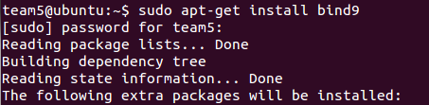
Install Bind9
To install Bind9 open a command prompt and enter this line,
sudo apt-get install bind9
you will be prompted for a password and once entered Bind9 will install and you’ll see a long list of packages being added to your system.
This is what the command looks like, from here a list of packages will begin

Slide 14
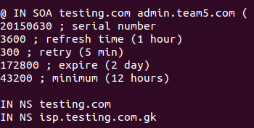
Create a forward lookup for the domain testing.com
First we’ll create a config file for this forward lookup. To do this use the line
sudo nano /etc/bind/testing.com
Now edit the file to match what you see on the right. Save and exit.
Note that everything that comes after a semicolon is a comment, and thus doesn’t affect the function and does not need to be exactly the same.

Slide 15

Create a record for your domain
Nano /etc/bind/zones/db.team5.example.com and add in your record, in this case we made an address or A record

Slide 16

Create 2 CNAME test1 and test2
Add CNAMEs in the config file for testing.com. This causes the name shown on the right to be aliased to the name shown on the left.
Meaning that any requests sent to the name on the left will instead be sent to that on the right.

Slide 17

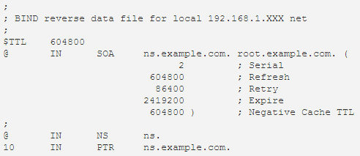
Configure reverse zone lookup for your domain
Go to the file
/etc/bind/named.conf.local
and add the text to the right.
Next make the file /etc/bind/db.192
and add the code on the right.

Slide 18
FTP

Slide 19
Install FTP
Use the command shown on the right to install FTP.
You’ll be prompted for a password, enter it and the installation will begin.

Slide 20
Configure so that only authenticated users can access and write documents in the FTP server.
To make users authenticate themselves, open the file /etc/vsftpd.conf and edit the Local_Users line to set it to yes.
Users will be able to sign in as long as they are listed in /etc/passwd file, and use their passwords.

Slide 21
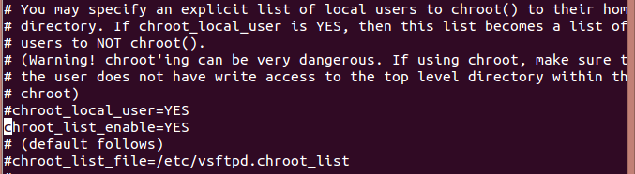
Limit users_20 through _25 to their home directory when the users log in to FTP vsfpd.chroot_list
To disallow certain users to leave their home directory in FTP, navigate to this part of the file,
/etc/nsftpd.conf/
and uncomment the line,
chroot_list_enable=YES
then put any users you want to restrict in a list in the file,
/etc/vsftpd.chroot_list

Slide 22

Disable access to FTP for user_10 -15
Add these two lines to the end of the vsftpd.conf file and then navigate to the file listed on the second line.
List all of the users you want to ban from using FTP and they will be unallowed to log in.

Slide 23

Do not allow anonymous users to upload files
In the vsftpd.conf file simply make sure the line to the right is commented out. As long as it is, anonymous users cannot upload files.

Slide 24
Enable SSL
sudo openssl req -x509 -nodes -days 365 -newkey rsa:1024 -keyout /etc/ssl/private/vsftpd.pem -out /etc/ssl/private/vsftpd.pem
Use this code to enable SSL.
This will create a certificate that can be used in the configuration file.

Slide 25
Make the FTP banner = "CIA- We are watching you"
Locate this line in the vsftpd.config file and you can set the banner to anything you want.

Slide 26
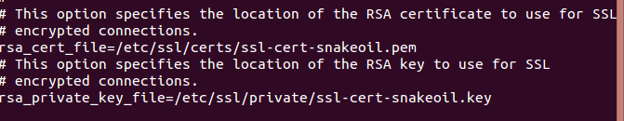
Write down the locations of RSA certificates
The locations of RSA certificates can be found at the bottom of the vsftpd.config file.

Slide 27
Make idle connection timeout = 500
Find the following line in the vsftpd.conf file and uncomment it. After that change the number after the = sign to 500.

Slide 28
LAMP
sudo apt-get install lamp-server^
Linux-Apache-MySQL-PHP

Slide 29
Apache
Web Server

Slide 30

Apply "ServerSignature off " to turn off the banner logging
nano /etc/apache2/apache2.conf

Slide 31
Make developer group the owner

Slide 32
Allow only the owner and group to have read, write, and execute privileges

Slide 33
Only let users have read rights

Slide 34
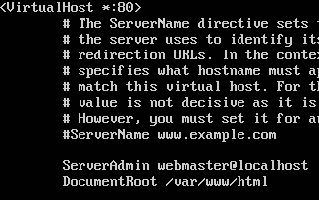
Write down the server admin
nano /etc/apache2/sites-available/000-default.conf

Slide 35
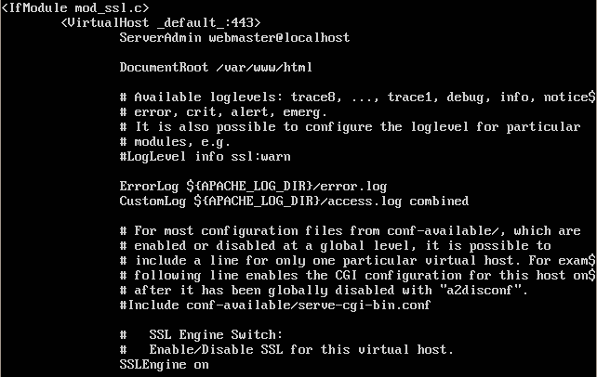
Make sure SSLEngine is on
nano /etc/apache2/sites-available/default-ssl.conf

Slide 36
Write down SSLCertificateFile and SSLCertificateKeyFile paths
In the same file

Slide 37
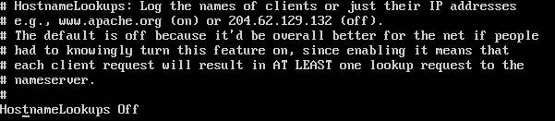
Hostname lookups is off
nano /etc/apache2/apache2.conf

Slide 38
MySQL
SQL Database Server

Slide 39
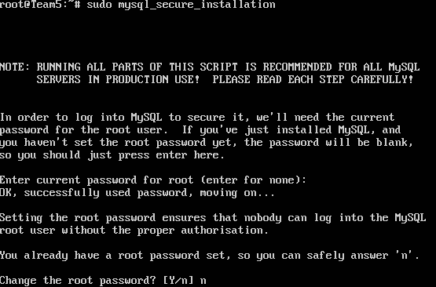
MySQL Secure Installation

Slide 40
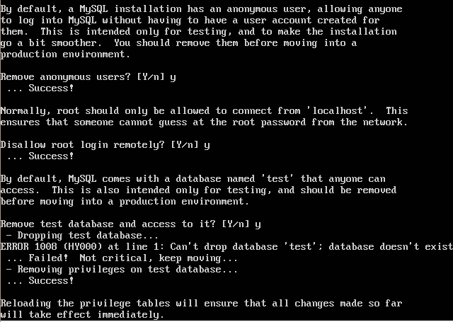
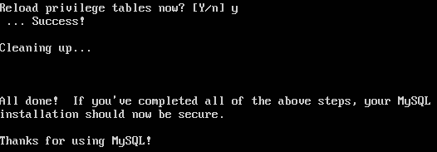
MySQL Secure Installation

Slide 41

Remove anonymous users
Type /usr/bin/mysql -u root -p to use the MySQL shell

Slide 42
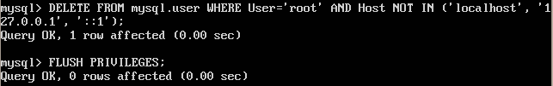
Disallow remote root login
DELETE FROM mysql.user WHERE User='root' AND Host NOT IN ('localhost', '127.0.0.1', '::1');

Slide 43
Resources
http://www.howtogeek.com/howto/linux/security-tip-disable-root-ssh-login-on-linux/
http://www.rackspace.com/knowledge_center/article/installing-mysql-server-on-ubuntu
https://help.ubuntu.com/lts/serverguide/dns-configuration.html

